Slide 1
CSE440: Natural Language Processing II
Dr. Farig Sadeque
Associate Professor
Department of Computer Science and Engineering
BRAC University

Slide 2
Lecture 3: ML Essentials

Slide 3
Topics
Classification
Feature representation
Probability
Naive Bayes
ML evaluation

Slide 4
Classification
Let’s see an example from “Where’s My Mom? by Julia Donaldson and Axel Scheffler ISBN-13: 978-0803732285”
Context: a baby monkey is looking for his mom, and cannot find her anywhere
A butterfly comes to help, asks the baby monkey how his mother looks like
And the story starts
Who is the classifier here? What are the features? What is a feature?

Slide 5
Classifier
Classifier = butterfly
Features
bigger than baby
not a great gray hunk
no tusks, trunk
knees not baggy
tail coils around trees
doesn’t slither, hiss
no nest of eggs
legs > 0

Slide 6
Classifier
Objects are described by properties or features
Classifiers make predictions based on properties
Good classifiers consider many properties jointly
Classifiers may overfit, i.e., perform well on training data, but poorly on unseen data
We will mostly use discriminative classifier in this course– where the classifier function tries to draw (or predicts) a border to separate different types of data.

Slide 7
Classifier
A classifier needs to be trained
We train a classifier on a set of data we call training data
We try to fit the classifier as best to our ability to the training data
Should we do this? Will learn soon
Then we try to predict the class of a new data that is not seen during training
This is the part where prediction comes in

Slide 8
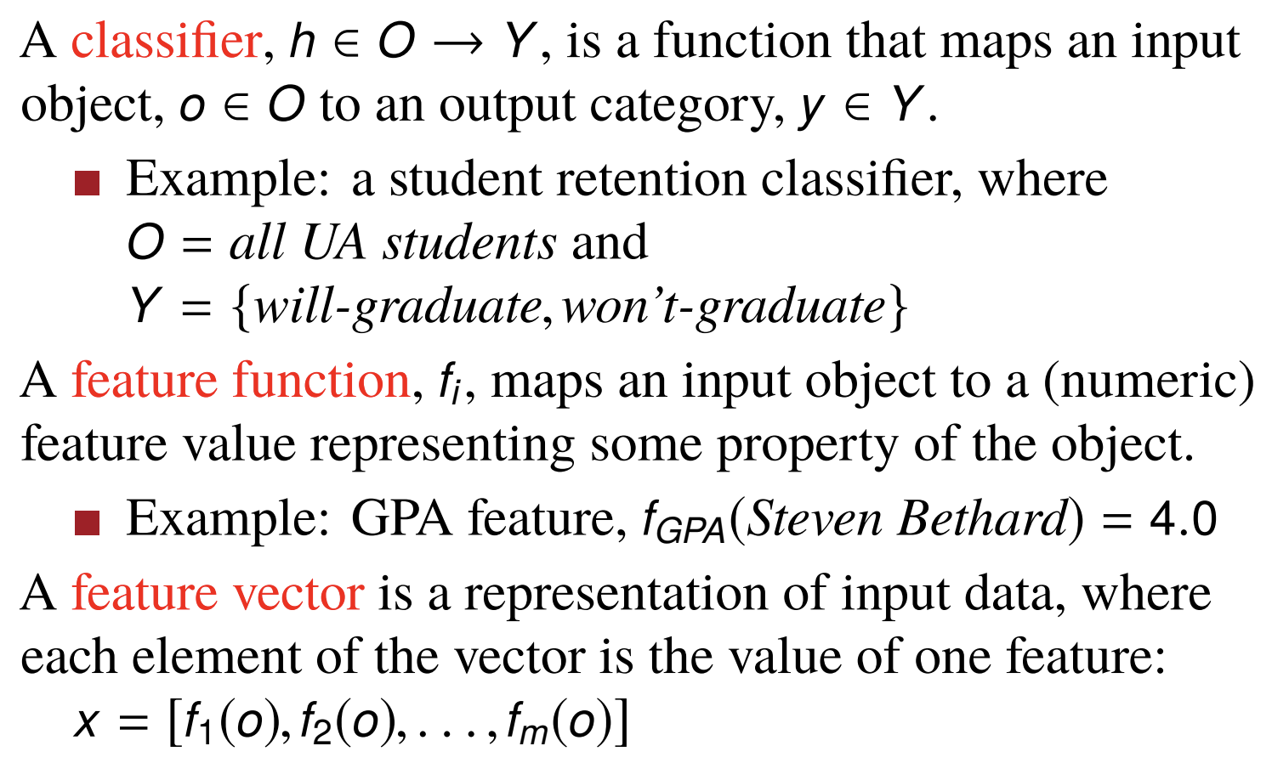
Formal definitions

Slide 9
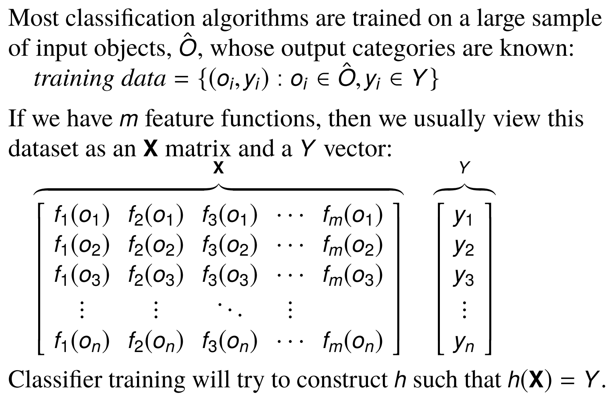
Classification in matrix form

Slide 10
Features are easy for regular ML task
Like you have seen in the butterfly classifier, or other examples
What features do we use when we are trying to classify a natural language data?
Let’s see an example: BoW features

Slide 11
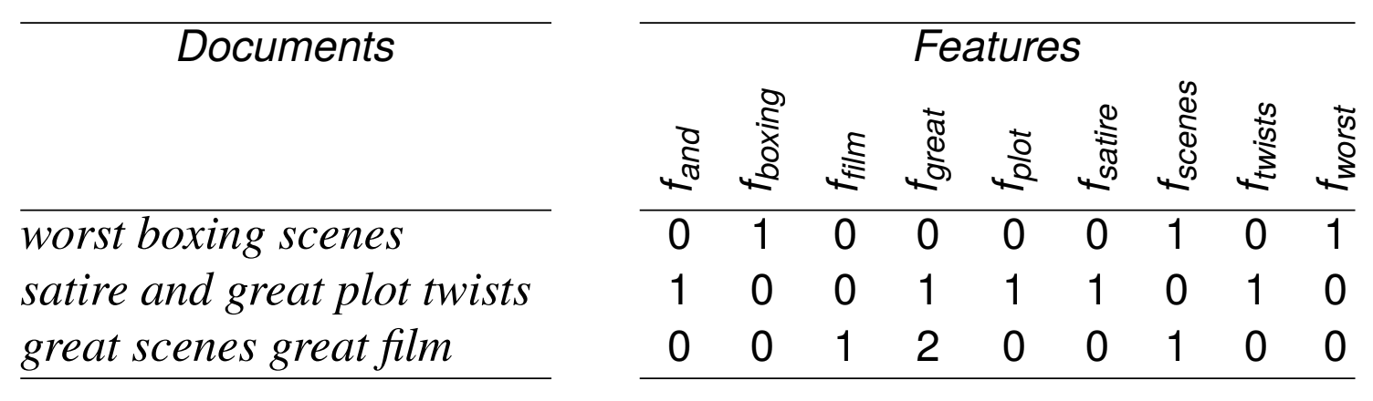
Bag-of-words features
A bag-of-words feature representation means that for each word in the vocabulary, there is a feature function, f_{i} that produces the count of word i in the text.
Example: f_{great} (great scenes great film) = 2

Slide 12
Bag-of-words features
How do we do it?
Very easy
Create a set of all possible unique words in the train data, w
For each of the sentences create a vector v of size |w| with every element initialized to 0
If a word i appears in that sentence, replace the 0 in v_{i} with the count of that word in that sentence
That’s it

Slide 13
What are the issues with BoW?
One feature function per word → large, sparse matrices
What’s wrong with sparsity?
Completely ignores word order
But often still useful

Slide 14
Classwork
Construct the feature matrix for these four text messages:
Sorry I’ll call later
U can call me now
U have won call now!!
Sorry! U can not unsubscribe

Slide 15
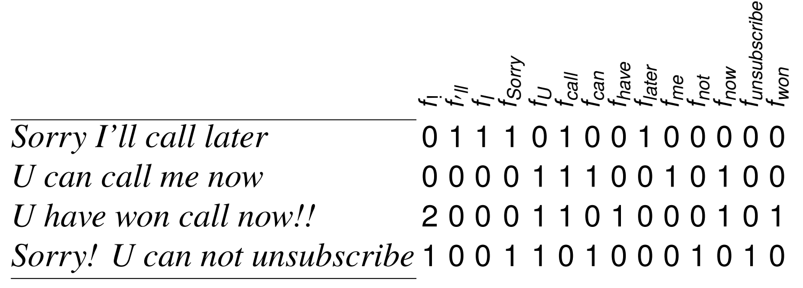
Classwork

Slide 16
What now?
So, we have learned what features are
Now, how are we going to use these features to classify a natural language data?
Let’s see one of the easiest types of classifier– it uses probability

Slide 17
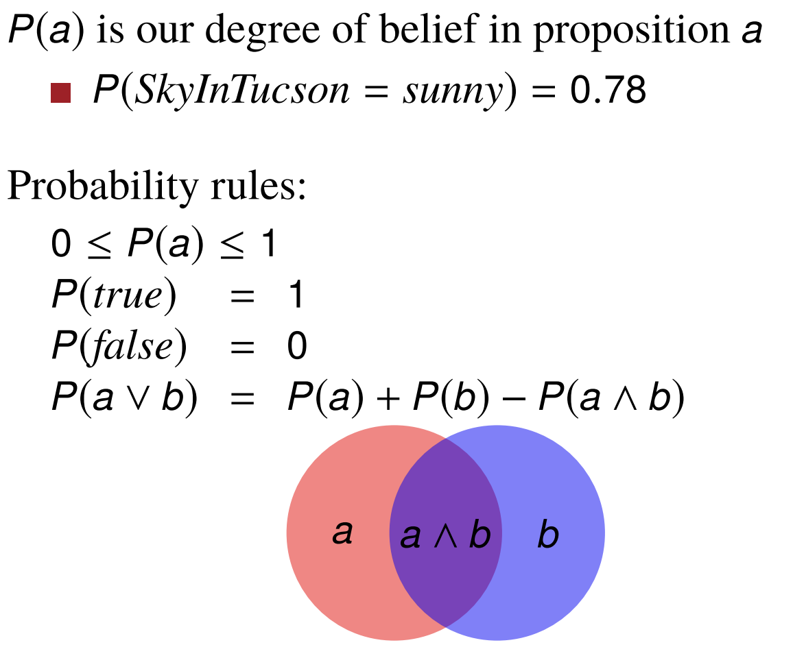
Probability review

Slide 18
Prior Probability
The unconditional or prior probability of a proposition a is the degree of belief in that proposition given no other information
P(DieRoll = 5) = 1/6
P(CardDrawn = A♠) = 1/52
P(SkyInTucson = sunny) = 286/365

Slide 19
Joint Probability
The joint probability of propositions a1, . . . , an is the degree of belief in the proposition a₁ ∧ . . . ∧ a_{n}
P(A,♠) = P(A ∧ ♠) = 1/52

Slide 20
Conditional Probability
The posterior or conditional probability of a proposition a given a proposition b is the degree of belief in a, given that we know only b
P(Card = A♠|CardSuit = ♠) = 1/13
P(DieRoll2 = 5|DieRoll1 = 5) =

Slide 21
Relation between Joint and Conditional
Product Rule
P(a ∧ b) = P(a|b)P(b) or P(a|b) = P(a ∧ b)/P(b)
P(A ∧ ♠) = 1/52
P(A|♠) = 1/13
P(♠) = 1/4
P(A|♠)P(♠) = 1/13 · 1/4 = 1/52

Slide 22
Bayes’ Rule
P(b|a) = P(a|b)P(b)/P(a)
Let’s derive this equation.
Purpose of Bayes’ rule: Swap the conditioned and conditioning variables

Slide 23
Conditional independence
Naïve Bayes classifier assumes conditional independence
Two events A and B are conditionally independent given an event C if
P(A∩B|C)=P(A|C)P(B|C)
A more general version:
P(A₁ A₂ A₃ … A_{n}|C) = ∏P(A_{i}|C)

Slide 24
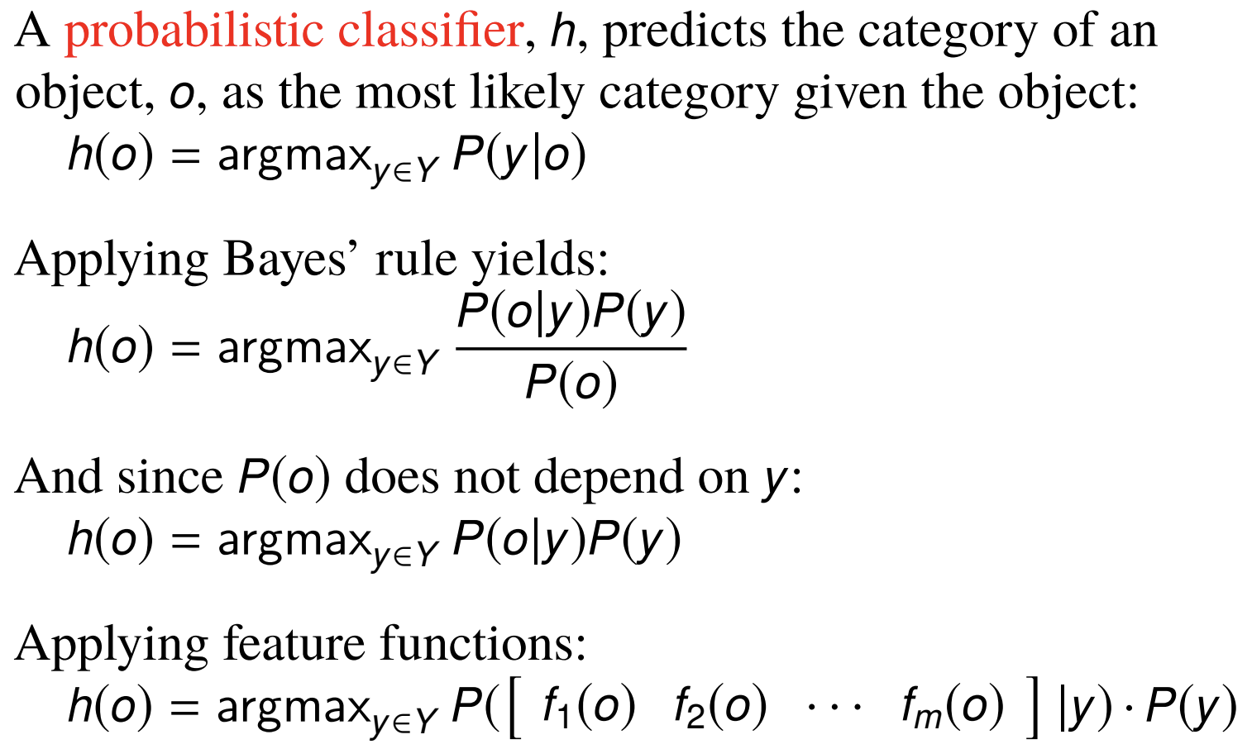
Probabilistic classifiers

Slide 25
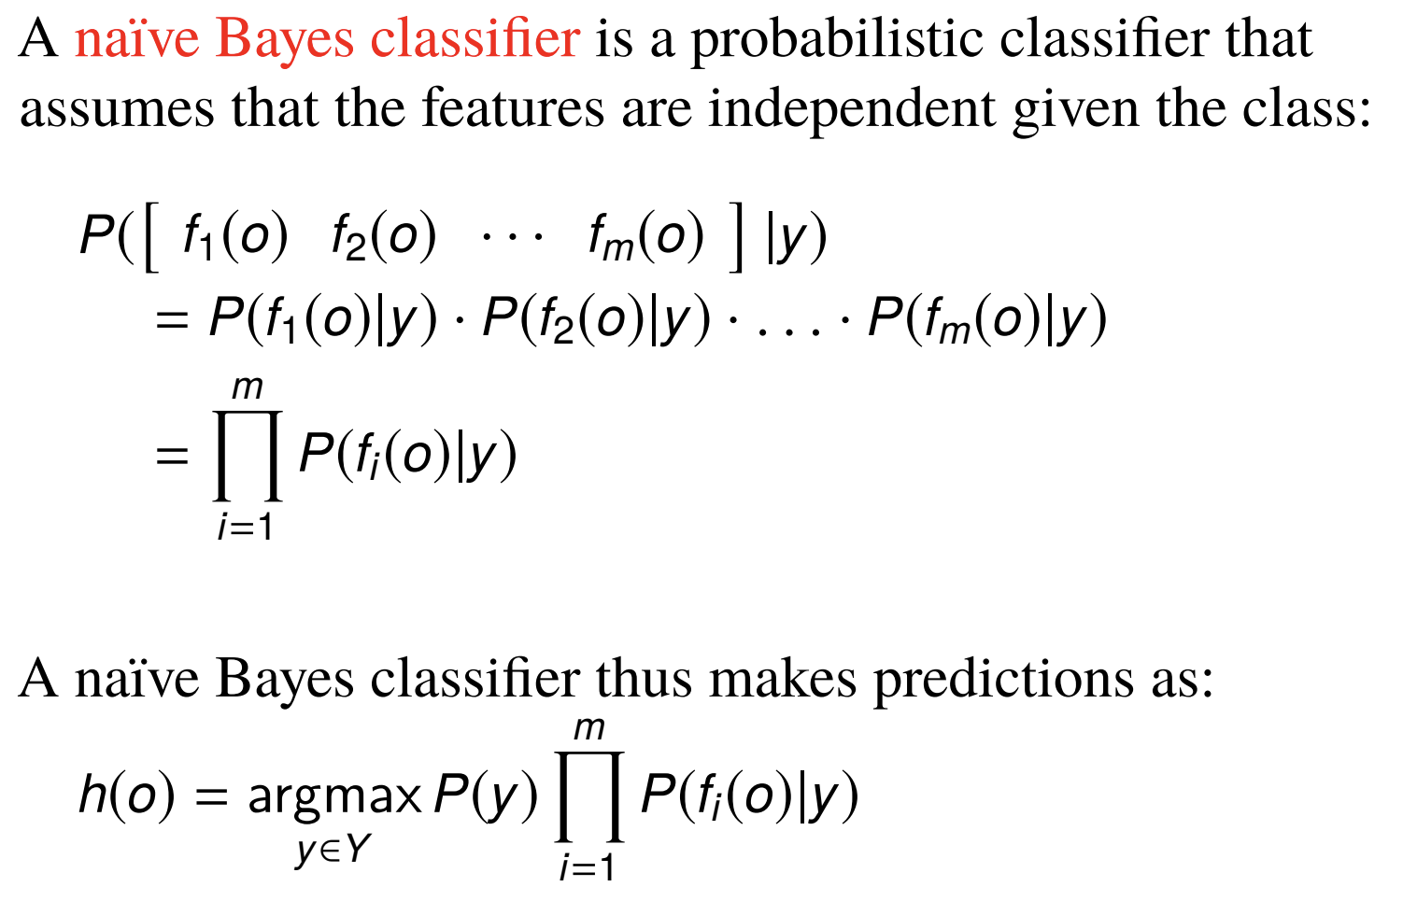
Naïve Bayes classifiers

Slide 26
Let’s classify
Or, in other words, train a classifier on train data and predict the class of a new data
We will need:
Prior probability of a class y; P(y)
And conditional probability of each feature f_{i} P(f_{i}|y)
Where do we get these probabilities from?
From the training data
This is the training phase
Recall from the equation in previous slide:
We multiply all these probabilities to get the final probability of a test data
This is the test phase

Slide 27
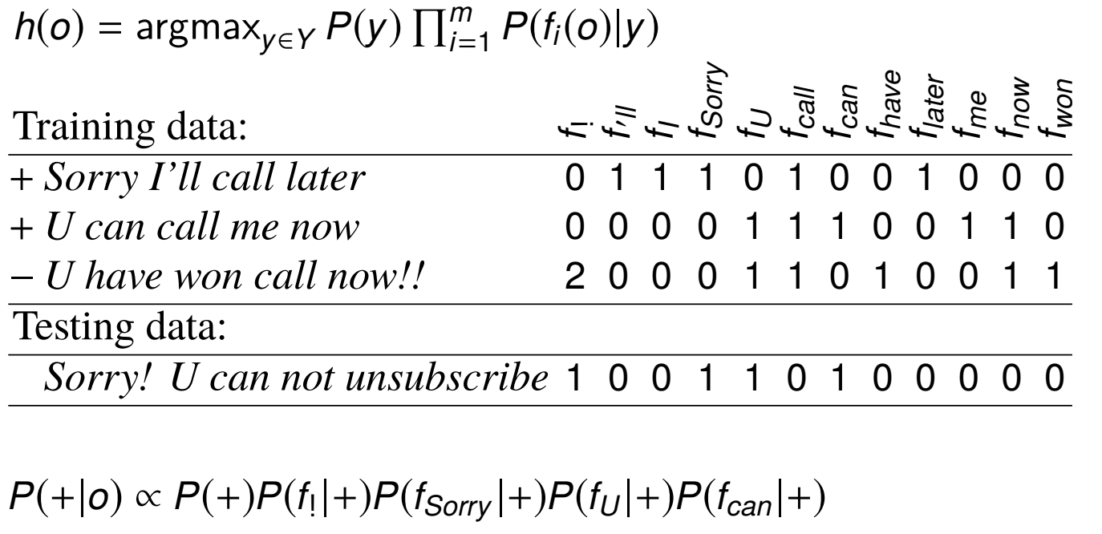
Let’s clear this up with an example

Slide 28
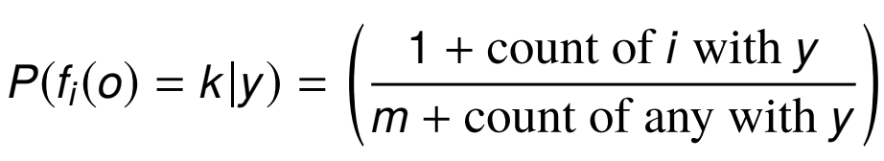
We have faced our first issue!
Multiplying probability always has this type of issue: if a probability is 0, the entire multiplication becomes 0
What should we do?
We use a technique called smoothing
m = number of unique words in the training data

Slide 29
Let’s try to do this example again, but now with smoothing

Slide 30
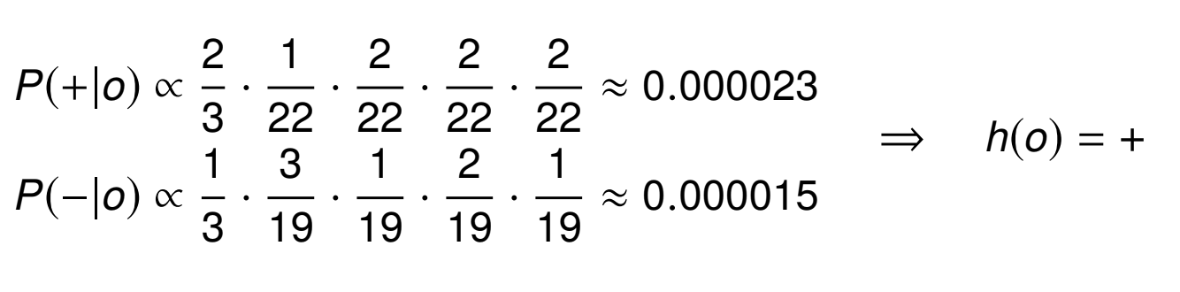
After the calculation

Slide 31
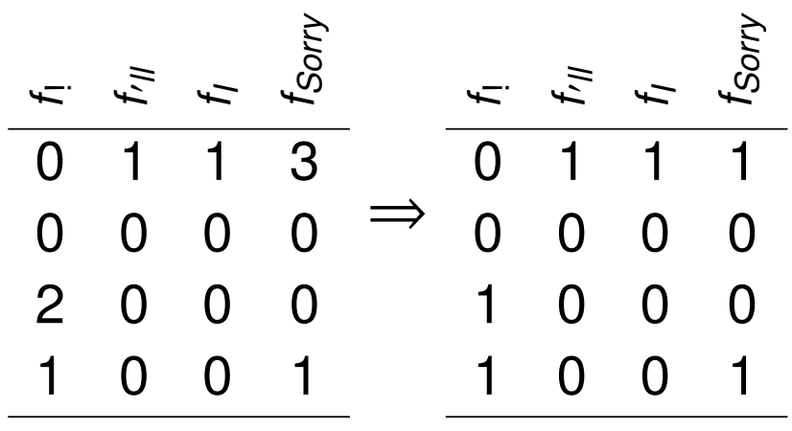
Refining features
Binarization
Binary multinomial naïve Bayes assumes that what matters is whether or not a word occurs in a document, not its frequency in the document.
Equivalent to removing duplicate words in each document.

Slide 32
Refining features
N-gram features
Instead of one word at a time, consider multiple words
Bag-of-words assumption is sometimes too simplistic:
good vs. not good
like vs. didn’t like
A bag-of-n-grams feature representation has a vocabulary that includes phrases (up to) n tokens long.
Example: f_{great film} (great scenes great film) = 1
This is bag-of-bigrams feature
bag-of-words = bag-of-1-grams (a.k.a. unigrams)
Consequences:
Vocabulary size grows quickly as n increases
Small counts; most n-grams never seen for large n
For word n-grams, typically n ≤ 3
For character n-grams, typically n ≤ 10

Slide 33
Refining features
Lexicon features
Sometimes there isn’t enough training data.
Example: sentiment training data that doesn’t include wretched, dreadful, genial, etc.
A lexicon is a list of words (not sentences or documents) that have been annotated for a task.
Example: the LIWC lexicon labels words for the categories Positive emotion, Family etc.
Lexicons are typically used to produce count features.
Example: f_{posemo} (great scenes beautiful film) = 2 if
great and beautiful are tagged as posemo in the lexicon

Slide 34
Rule-based features
There are no limits on the algorithm that a feature function may apply.
Examples:
How many times does [$][\d,]{7} match?
What proportion of first line’s characters are capitals?
What is the ratio of text to image area (in HTML)?

Slide 35
Probabilistic learners are simple
In everyday life, the learners we use make mistakes and then learn from mistakes
Let’s say we want to draw a line to separate spans vs. not spams (linear regression classifier)
The line splits the spams and not spams into two regions
If a spam falls in the non-spam region, the classifier made a mistake
This line is called a “decision boundary”
How do we do that?
We can penalize the model for making mistakes
How can we penalize? Should we penalize the same amount for every mistake it makes?
Enter the idea of Loss

Slide 36
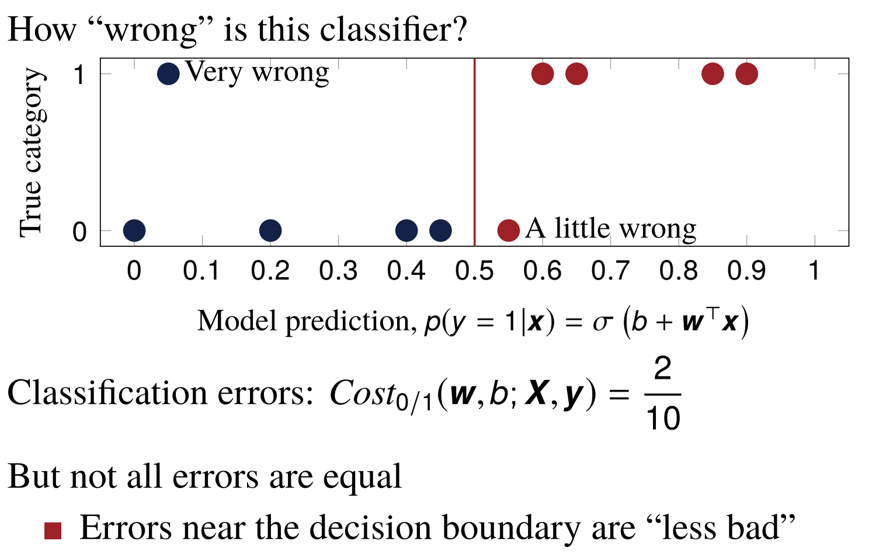
Loss

Slide 37
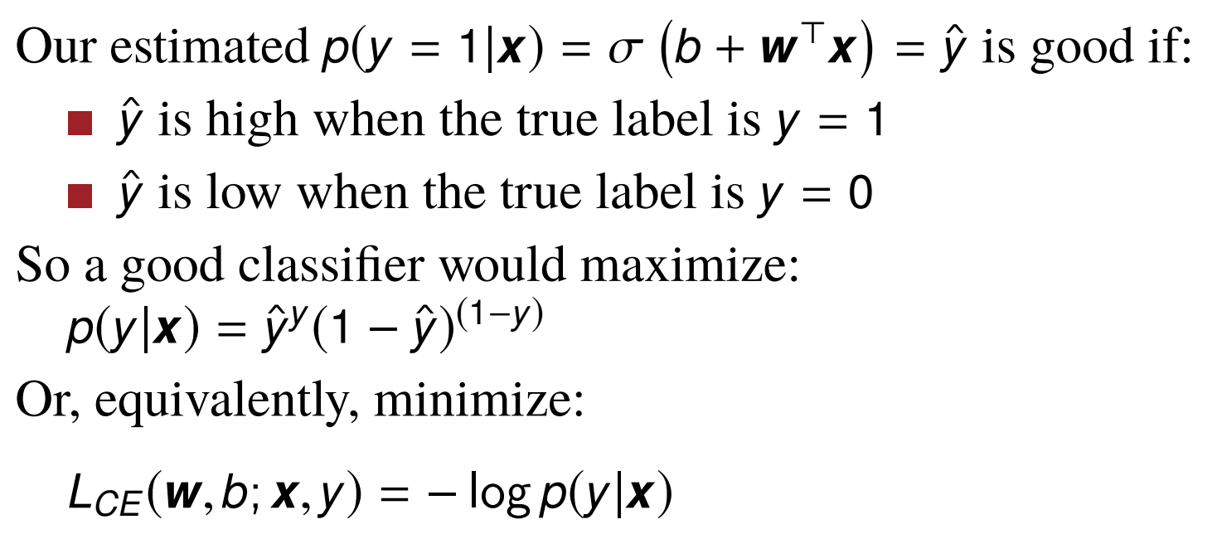
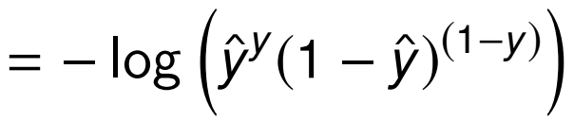
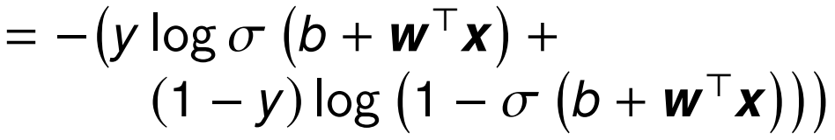
Cross entropy loss

Slide 38
Cross entropy loss
This cross-entropy loss, L_{CE}(w, b; x, y), measures how bad w and b are on the single example (x, y).
An ML model runs through each of the training examples and tries to reduce this cross entropy loss as it goes along– and thus learns the pattern in the examples
Sometimes, a model goes through all training examples multiple times to reduce the loss further
Each of these run is called an epoch

Slide 39
ML best practices
Data splitting
Underfitting and overfitting
Performance metrics
Statistical significance

Slide 40
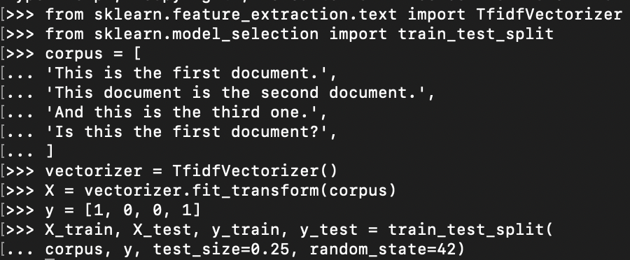
Data splitting
Train classifier on data E_{train}
Test classifier on E_{test}

Slide 41
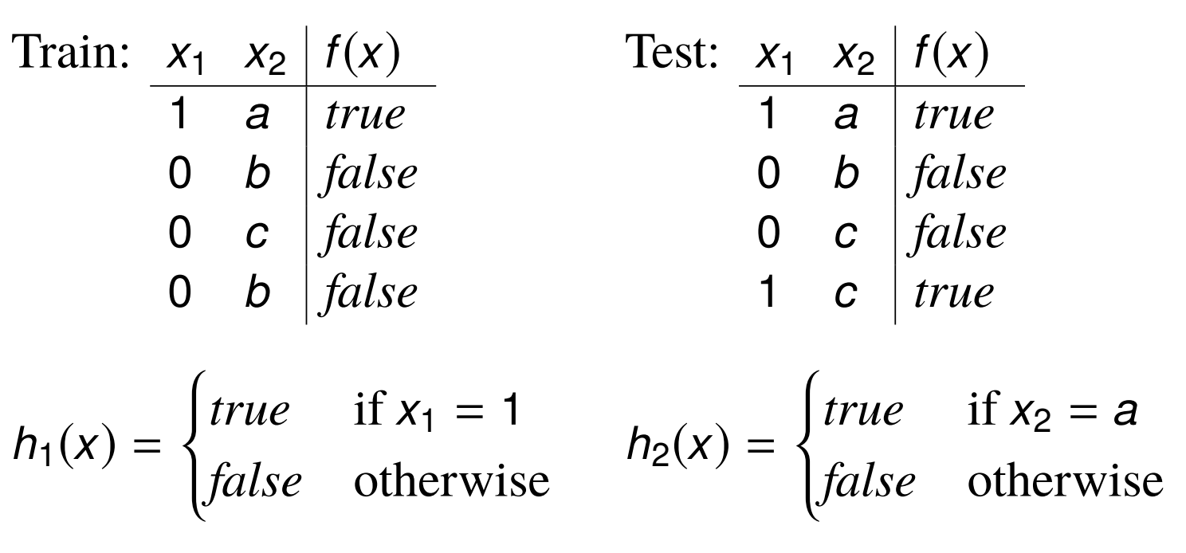
Data splitting
Never peak into the test data!
Not even accidentally
What are the accuracies of these models?
How do you improve them?

Slide 42
Data splitting: improving a model
Bad idea
Train on the train data
Evaluate on test data
Go back to the training phase and tune parameters
What will it do?
Better idea
Split data into three parts
Train on the major chunk of the data (E_{train})
Tune on a very small piece of data (E_{val})
Test on another small chunk of data (E_{test})

Slide 43
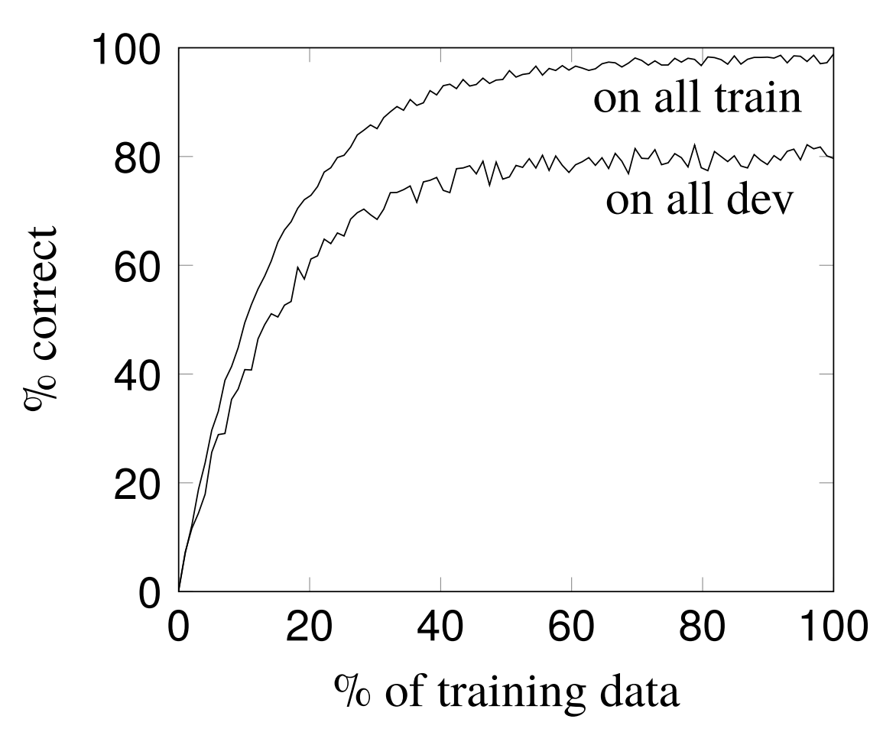
Underfitting and Overfitting
Learning Curve

Slide 44
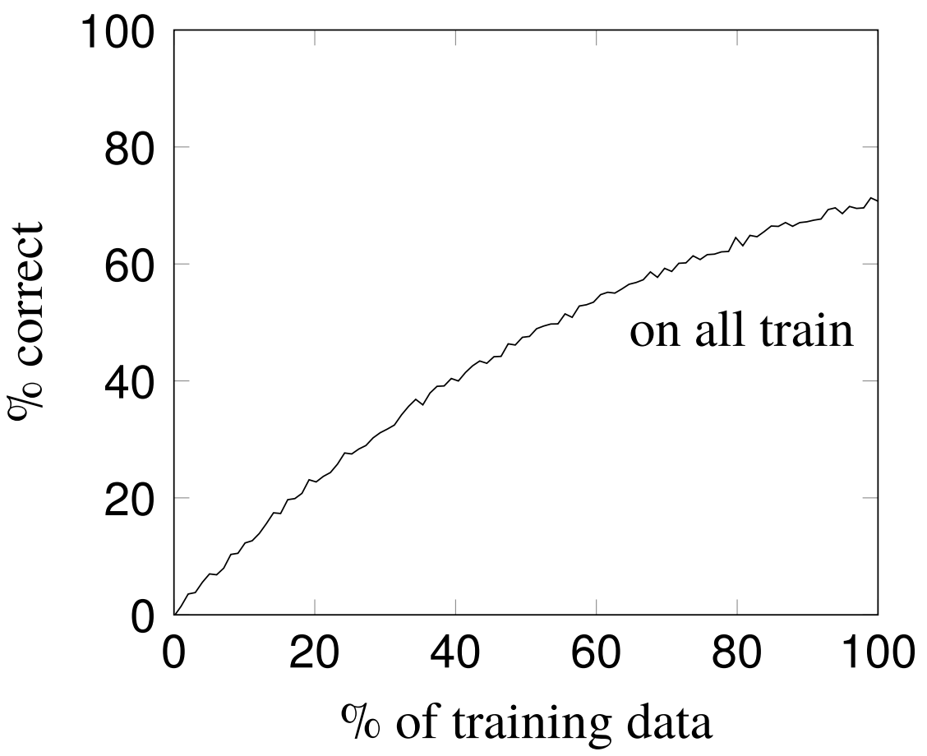
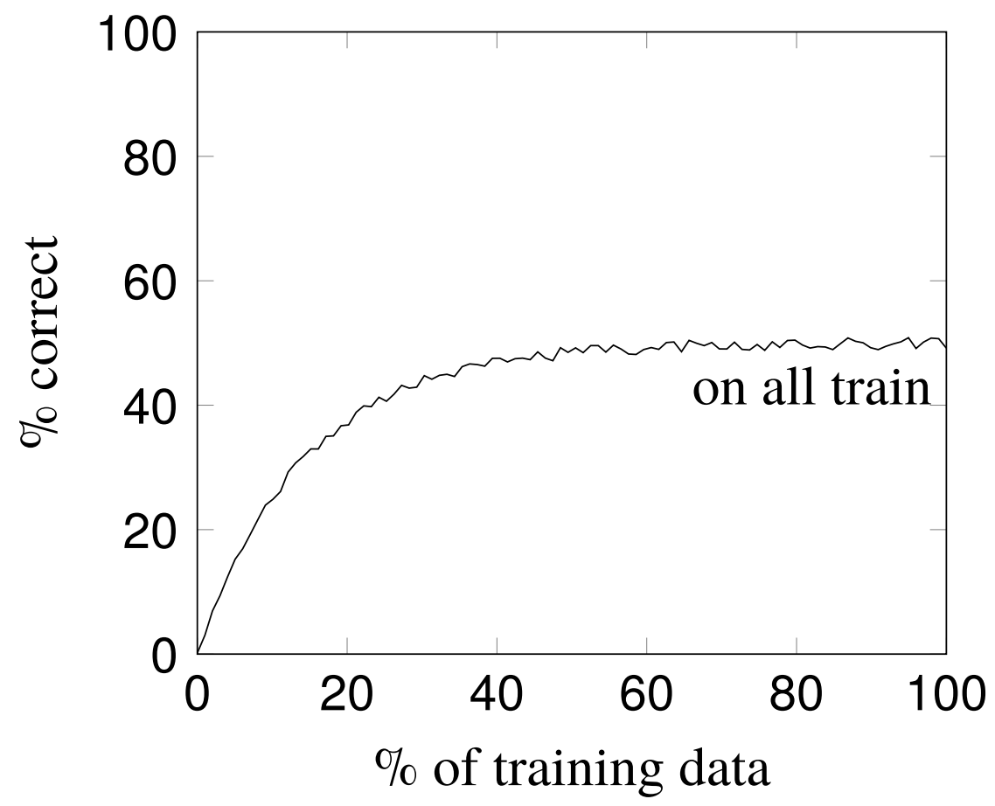
Underfitting
Insufficient training data Model is too simple

Slide 45
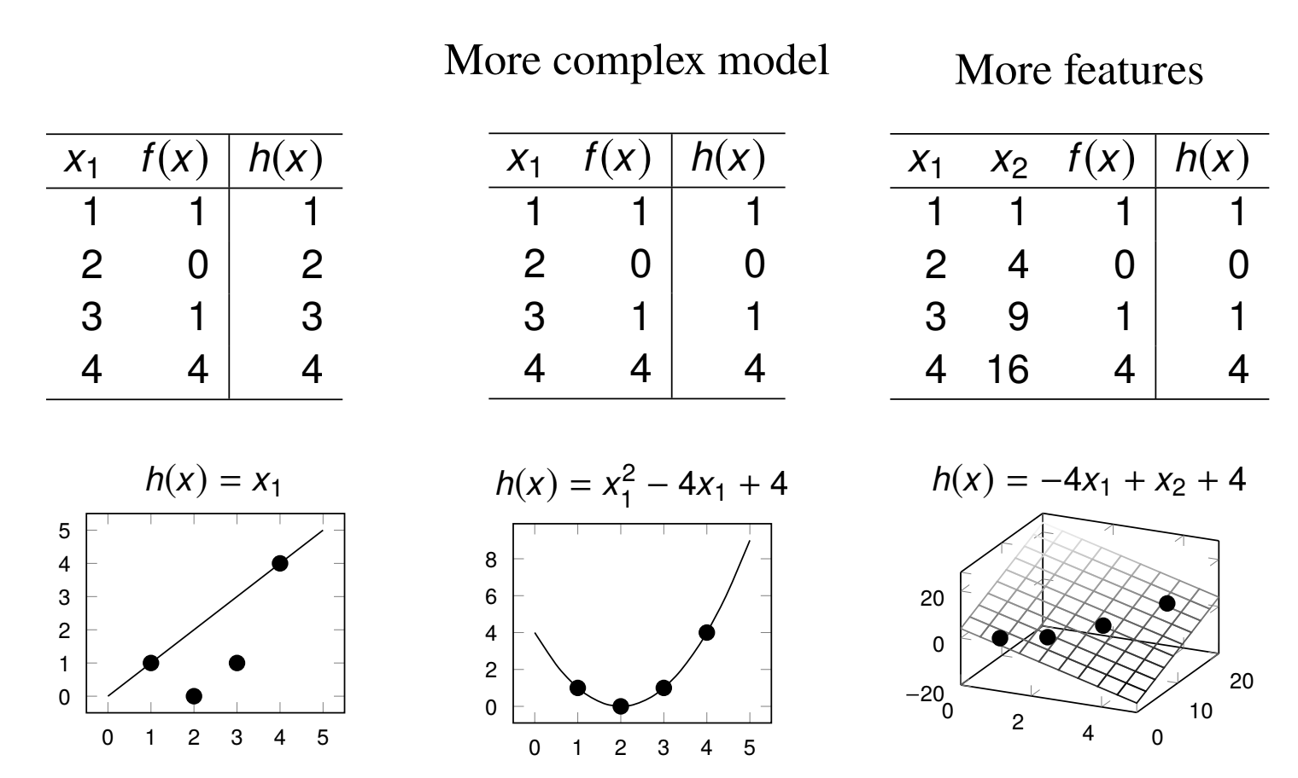
Addressing underfitting

Slide 46
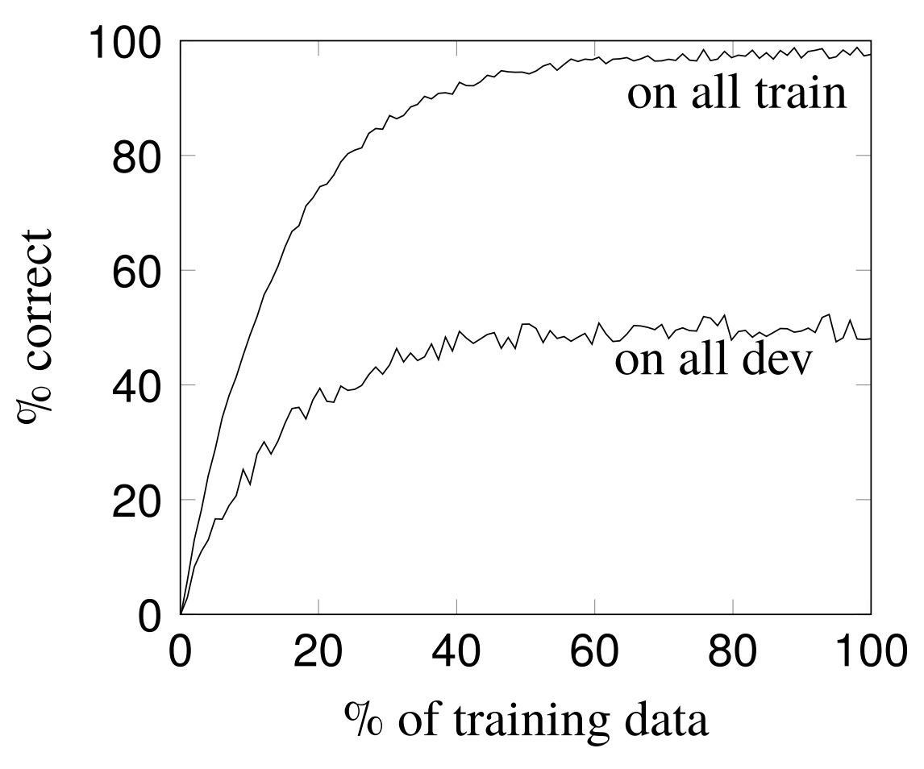
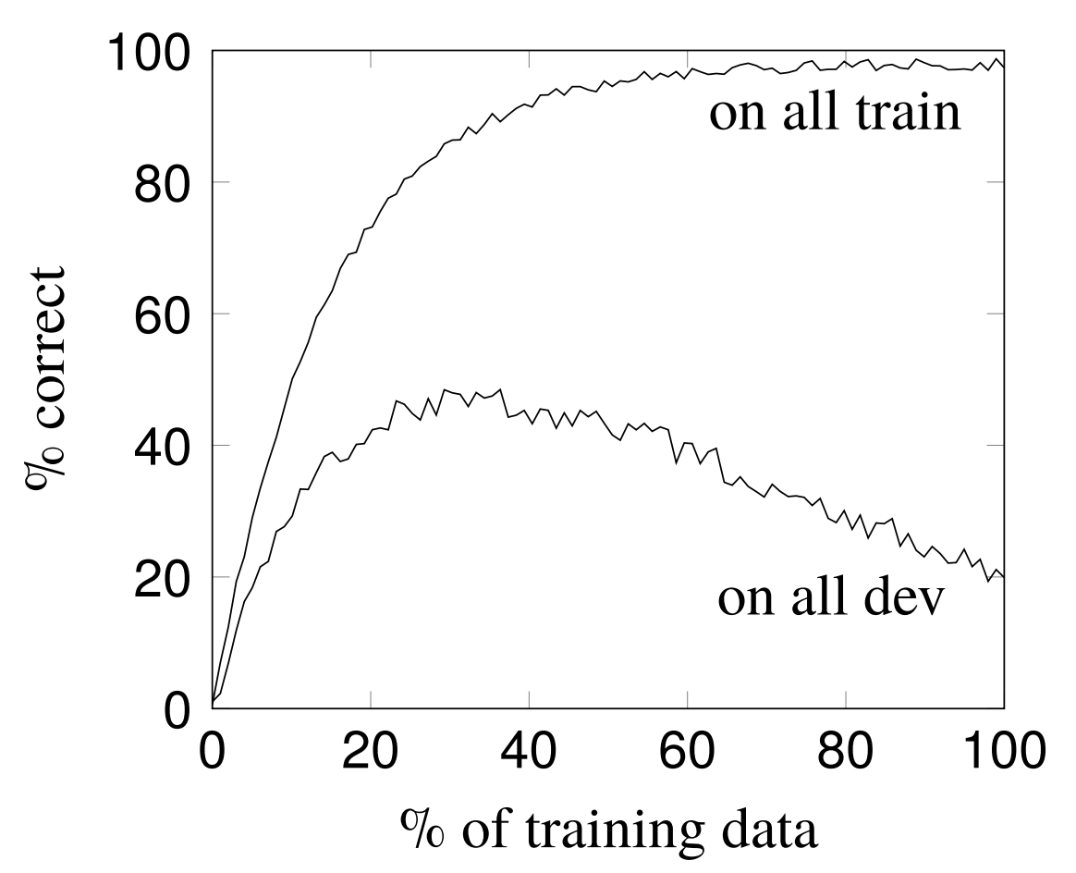
Overfitting

Slide 47
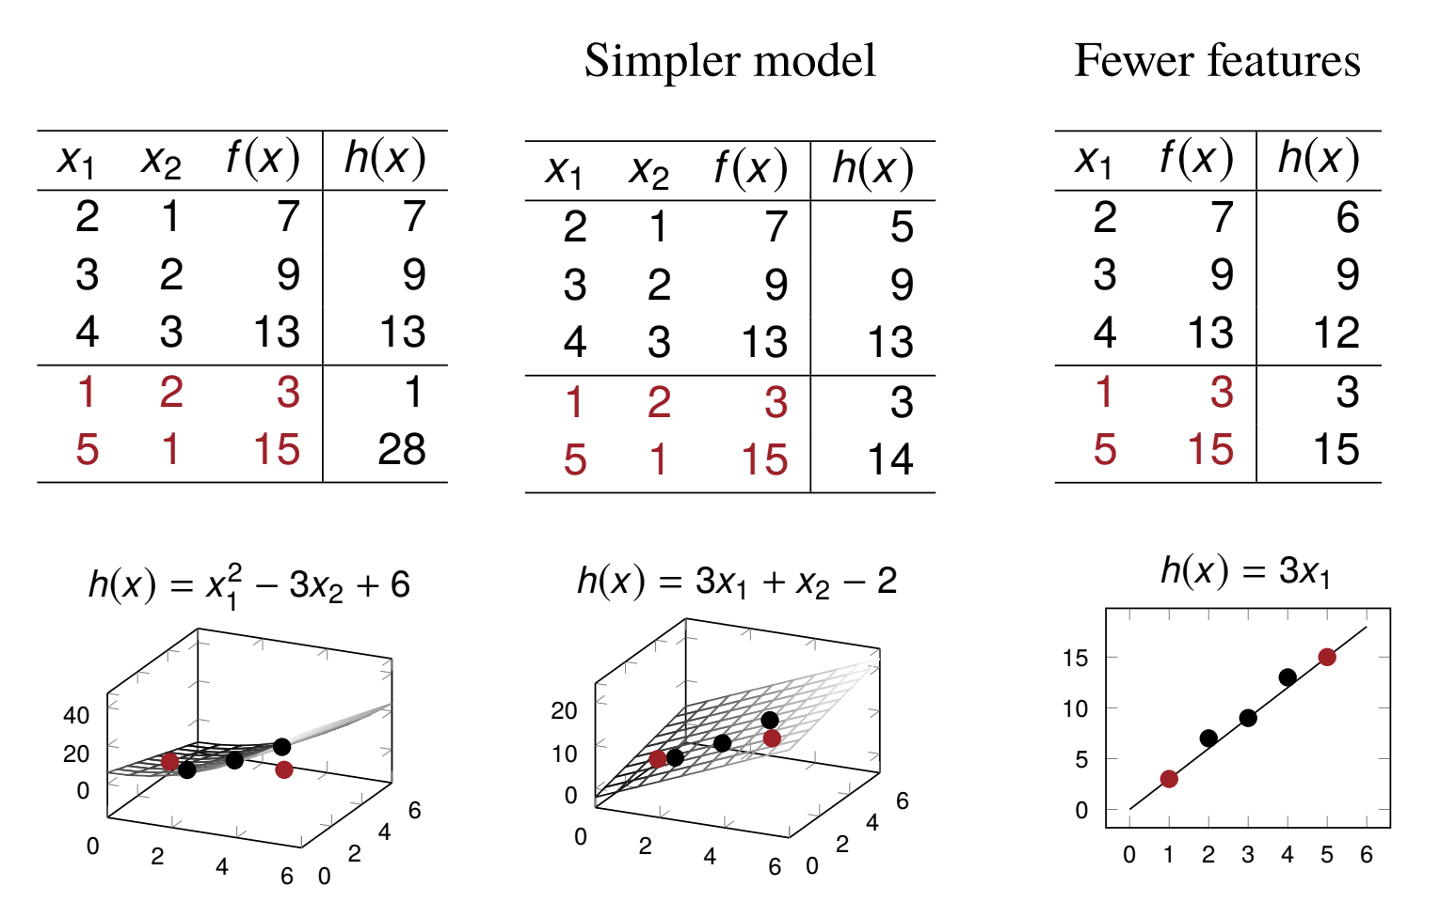
Addressing overfitting

Slide 48
Performance metrics
Accuracy is a bad performance metrics
the distribution of categories is unbalanced, or
you care about one category more than the others
Example: detecting spam in text messages
Example: diagnosing depression from tweets
What should we do?
Use other metrics: precision, recall, F-1 score

Slide 49
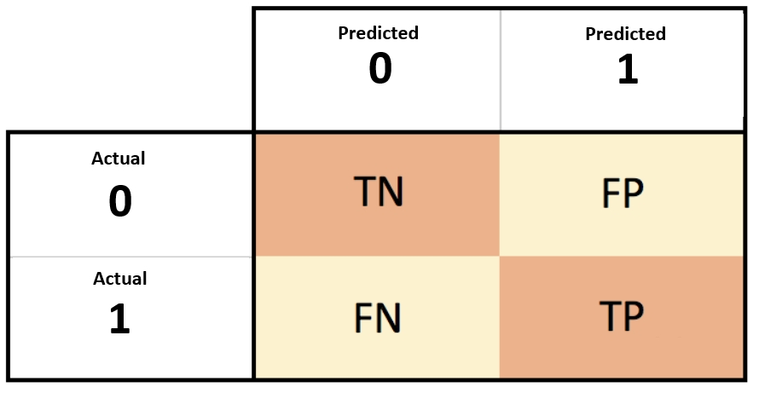
Confusion matrix

Slide 50
Precision, recall and F-1 score
Precision = ratio between true + (or -) and predicted + (or -)
Recall = ration between true (or -) and actual + (or -)
F-1 score: Harmonic mean of precision and recall
There are other task-specific metrics as well:
BLEU: machine translation
WER: ASR
Cosine similarity: semantic similarity
Euclidean distance: spell checking
F-latency: early detection

Slide 51
More than one category of interest
Sometimes we care about more than one category in classification
In sentiment analysis we care about both positive and negative sentiments
Use
Macro-average: our regular average
Micro-average: combine-and-calculate
Let’s calculate macro- and micro-average precision for this case:
We predicted 51 sentences as positive and and 42 as negative, where 37 of them were actually positive and 18 were actually negative
What is macro-precision?
What is the micro-precision?

Slide 52
Statistical Significance
On some test set T, classifier A gets .992 F1, B gets .991 F1.
Is A actually better than B?
Competing hypotheses:
A is generally better than B
A was better than B by chance on T, but would not be better than B in general, i.e., the null hypothesis (H₀)
We would like to reject the null hypothesis if we want to establish that A is actually better than B
How to do this? One way can be:
We can do some sort of statistical significance test (Student’s t-test) using multiple samples
If the test value is less than than a preset critical value (p-value), we reject the null hypothesis
How to get the samples? Many ways (e.g. cross-validation)
Notes:
We can do a student t-test (if the distribution is normal): calculate the t-value and compare it to a preset p-value
P-value often is 0.05 or smaller– this means if we run the test 100 times, 95% of the times we will reject the null hypothesis. The lower the -value, the more confident we are that A > B.
If our t-value is less than the value in the corresponding p-value column, we can say that A is statistically significantly better than B

